Slide 1

Title: "ENCHAINED EPHEMERA ":THE LIBRARY OF PETRIFIED DREAMS
Student Name: Jasmitha
Student ID: 2520030557
Cluster: 4
Section: 14
Under the Guidance
of
Supervisor Name: Sudhakar
Assistant Professor
Department of CSE

Slide 2
OUTLINE
Abstract
Existing System
Proposed System
System Architecture
Project Modules
Objectives
Co’s Attainments - FWD
Co1
Co2 …….. 5. Co5
Co’s Attainments - DSA
Co1
Co2 …….. 5. Co5
Screen Shots for FWD & DSA
Conclusion
Geo-Tagged Photos

Slide 3
Abstract
• A single-page web app reimagining productivity as an act of magical stewardship, set in a metaphysical library where procrastinated time turns to stone.
• Centers on Lyria, a Fae of Focus imprisoned in a glass cage whose opacity directly mirrors the user's real-world attention and focus quality.
• Sustained focus clears the cage and makes the ecosystem bloom; distraction summons the Granite Moth, which progressively petrifies landscape features.
• Users earn Lumen(focus currency) redeemable to purify petrified objects, banish the Moth, or plant permanent milestone flowers.
• Liberation is a week-long ritual — seven focused sessions forge a Chain of Concentration, ending in an interactive cutscene where typed concepts shatter the cage.
• Tone is melancholy potential, not punishment — return is honored over perfection, and stone is framed as tragic waste rather than moral failure.
• Art direction blends ethereal digital painting, subtle pixel animation, and bioluminescent ecology inspired by Studio Ghibli and Monument Valley.
• Reframes focused work not as a chore, but as an act of creative, magical preservation— the user doesn't just study; they sustain a living world.

Slide 4
Existing System
Forest App – Pomodoro timer where trees grow if you stay focused; leaving the app kills the tree.
Spirit City: Lofi Sessions – Focus sessions unlock spirits and build a cozy virtual environment.
Habitica – Turns productivity tasks into RPG quests with rewards and leveling.
Finch – A virtual pet grows and explores as you complete real-life tasks.
Lofi productivity apps (like LifeAt.io) – Provide ambient environments and timers for focus.

Slide 5
Proposed System
A gamified productivity web application where user focus sessions help restore a magical world.
Users start a Pomodoro study timer, and uninterrupted focus generates “Lumen” energy.
The energy weakens the glass cage imprisoning the fairy Lyria and restores the Glimmer-glade environment.
Distractions or tab switching summon the Granite Moth, which slowly petrifies parts of the realm.
Completing sessions earns Lumens, which can revive petrified objects, grow Focus Lilies, or unlock story lore.
Consistent focus across days builds a “Chain of Concentration.”
After 7 successful days, users unlock a ritual event that frees Lyria and transforms the realm into a personal focus sanctuary.

Slide 6
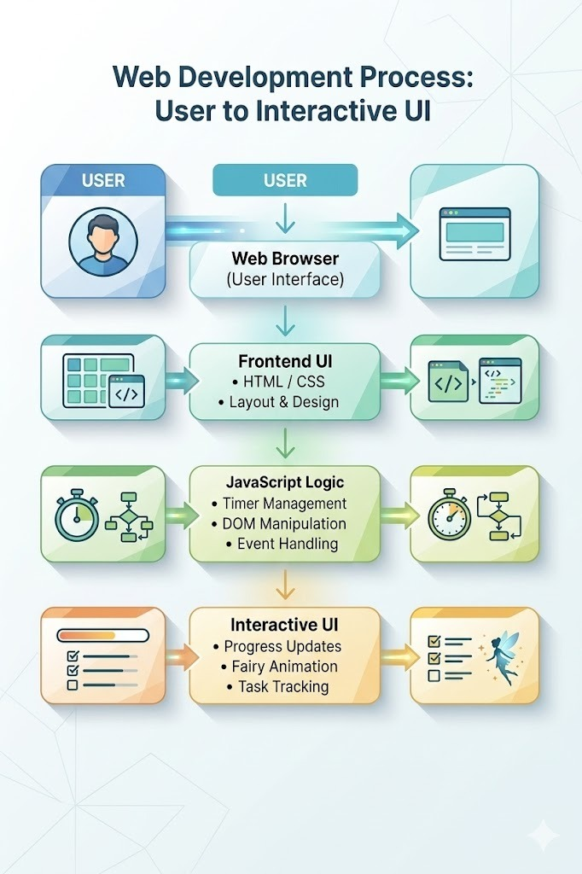
System Architecture

Slide 7
Project Modules
1. User Interface Module
Provides the main website interface.
Built using HTML and CSS.
Displays:
Home page
Navigation menu
Fantasy library sections
Story / dream collections.
2. Dream Archive Module
Stores and displays petrified dreams or magical stories.
Organizes them into categories or collections.
Allows users to browse and read dream records.
3. Search & Explore Module
Allows users to search for dreams or stories.
Helps users explore the enchanted archive easily.
Displays results dynamically.

Slide 8
PROJECT MODULES
4. Interactive Features Module
Implemented using JavaScript.
Handles:
Button interactions
Dynamic content updates
User navigation effects
Interactive reading experience.
5. Registration / Visitor Module
Allows users to register as dream explorers.
Collects:
Name
Email
Dream interest
Displays submission confirmation.
6. Browser Execution Module
Runs the application in the web browser.
Handles:
DOM manipulation
Event handling
UI rendering
User interactions

Slide 9
Objectives
To design an interactive fantasy-themed productivity web application that encourages focused study.
To implement HTML, CSS, and JavaScript concepts for building a responsive and visually engaging interface.
To develop a focus timer and progress tracking system to help users manage study sessions effectively.
To incorporate gamification elements (fairy, magical realm, progress growth) to motivate consistent learning.
To apply DOM manipulation and event handling for interactive user actions.
To demonstrate the use of modern web design techniques such as responsive layouts, animations, and dynamic content.

Slide 10
Co’s Attainments - FWD
Course Outcome 1: Internet Fundamentals, HTML & Introductory CSS
Implemented HTML document structure using <html>, <head>, and <body>.
Used headings, text elements, and meta tags for webpage structure.
Applied CSS styling with selectors, typography, and color properties.
Used spacing properties like margin, padding, and borders.
Integrated external fonts using Google Fonts.
Course Outcome 2: HTML Forms, Semantic Tags & CSS Layouts
Created HTML forms using input fields, text-area, and select elements.
Designed structured content using containers and layout sections.
Implemented CSS Grid and Flexbox for page layout.
Used CSS animations, transitions, and hover effects.
Applied responsive design using media queries.

Slide 11
Co’s Attainments - FWD
Course Outcome 3: JavaScript Programming Essentials
Used JavaScript functions and basic logic.
Implemented timers using setInterval().
Used event-driven programming for user actions.
Course Outcome 4: JavaScript Interactivity & DOM
Performed DOM manipulation using querySelector() and getElementById().
Implemented event handling with addEventListener().
Added interactive UI behavior using JavaScript
Course Outcome 5 : Advanced Web Development &Deployment
Implemented dynamic user input handling through forms.
Used responsive design with meta viewport tags.
Integrated external resources and optimized page layout.

Slide 12
Co’s Attainments - DSA
Applied basic algorithm logic in JavaScript for timer and interaction flow.
Used searching of DOM elements with querySelector() and getElementById().
Represented tasks and tags using List ADT concepts.
Demonstrated applications of lists through task management.
Used sequential execution with setInterval() and setTimeout(), similar to queue-like operations.
Implemented structured steps for progress tracking and user interactions.

Slide 13
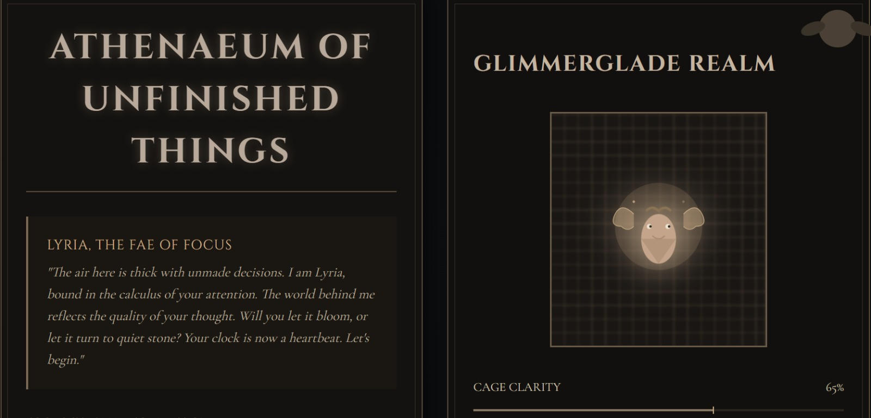
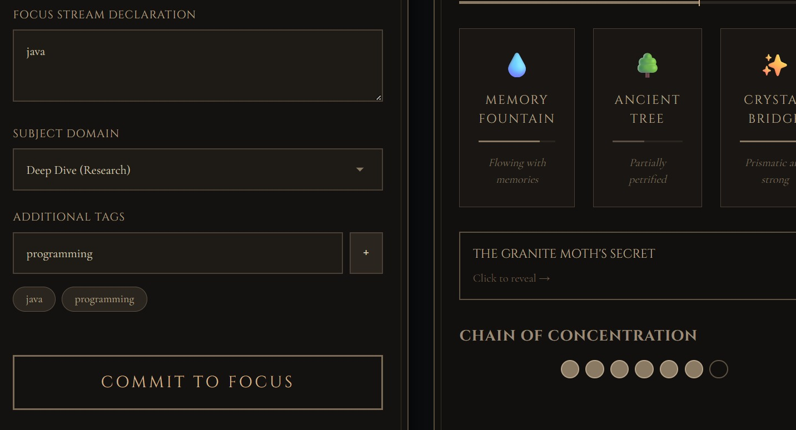
Screenshots for FWD & DSA

Slide 14
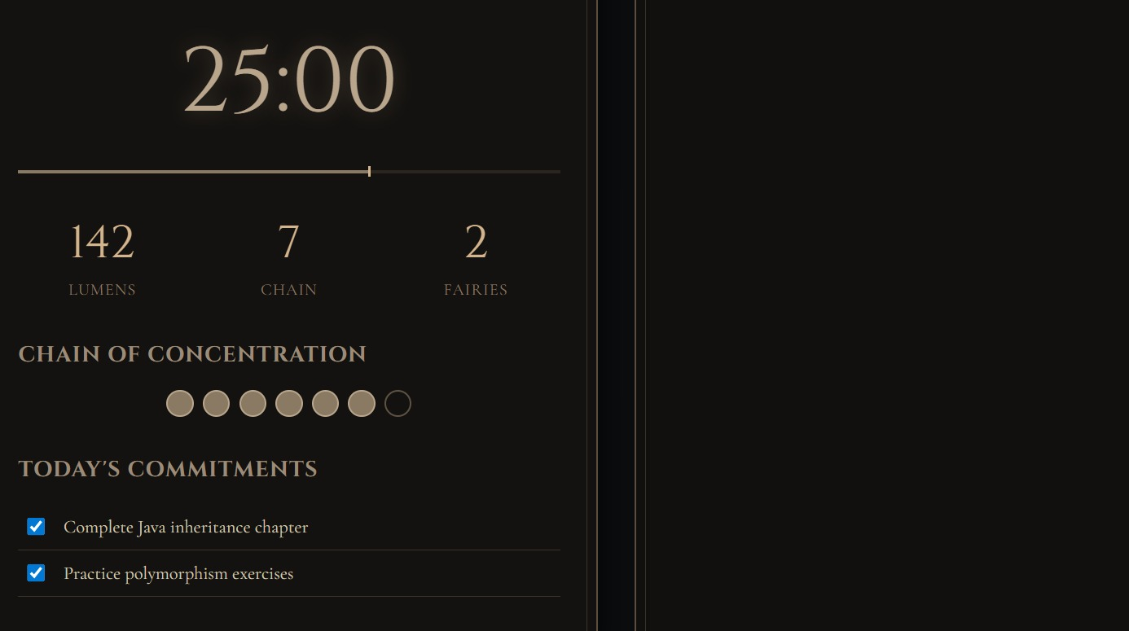

Slide 15
Conclusion
The Enchained Ephemera: The Library of Petrified Dreams project combines productivity tools with an immersive fantasy environment.
It transforms regular study sessions into a motivating and interactive experience through storytelling and visual progress.
Features like the focus timer, progress tracking, and Chain of Concentration help users maintain consistent focus.
The Glimmer-glade Realm and trapped fairy act as symbolic rewards, where user productivity gradually restores the magical world.
The project demonstrates how gamification and creative design can reduce procrastination and improve engagement.
It highlights the potential of interactive web technologies to build emotionally engaging productivity applications.
Overall, the system encourages users to stay focused while experiencing a unique blend of technology, art, and fantasy storytelling.

Slide 16
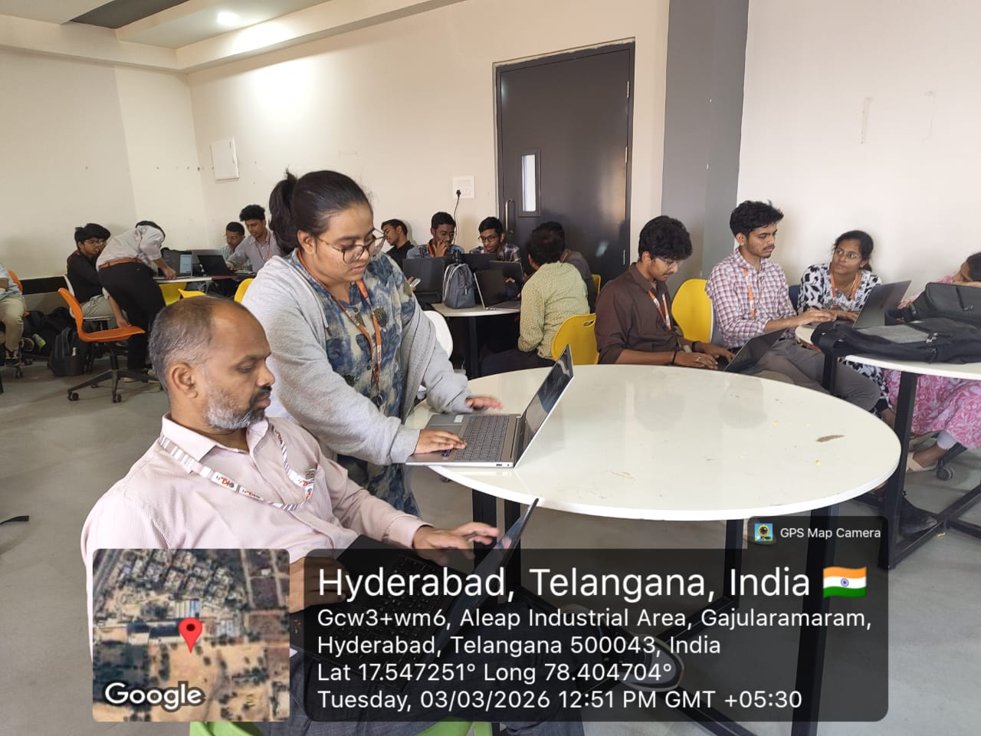
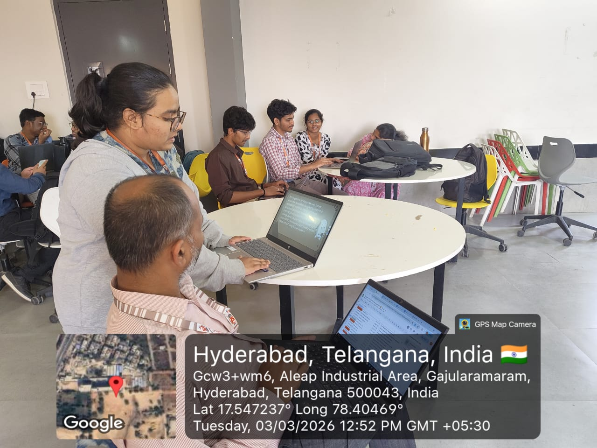
Geo- Tag Photos

Slide 17
THANK YOU

